Slide 1
Online Retail Customer Segmentation & Revenue Analysis Leveraging RFM Analysis and K-Means Clustering

Slide 2
Agenda
DATA PREPARATION 3
CUSTOMER SEGMENTATION 4-6
EXECUTIVE DASHBOARD 7
KPIs , FINDINGS AND BUSINESS INSIGHTS 8-17
CONCLUSION 18

Slide 3
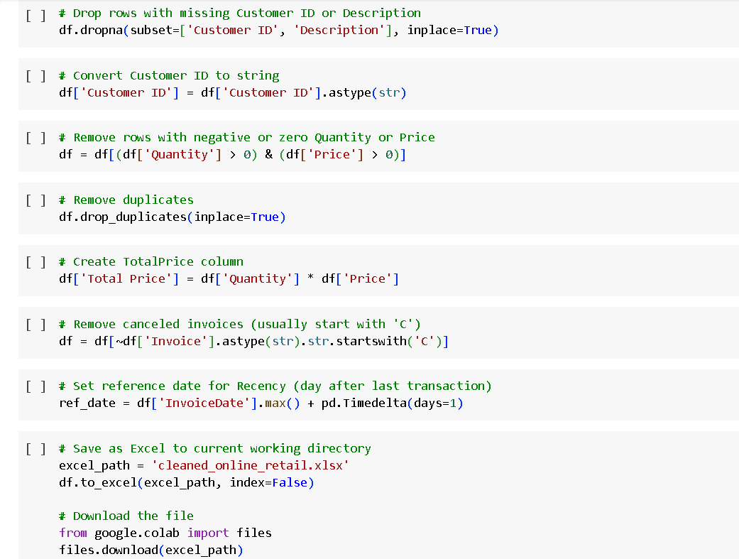
Data Preparation for Reliable Insights
Key Steps:
Removed rows with missing Customer ID or Description.
Filtered out invalid transactions:
Negative/zero Quantity or Price.
Canceled invoices (starting with 'C').
Dropped duplicate records.
Created Total Price column: Quantity × Price.
Set reference date for Recency calculation (day after last transaction).
Why It Matters: Ensured data quality and consistency for accurate segmentation.

Slide 4
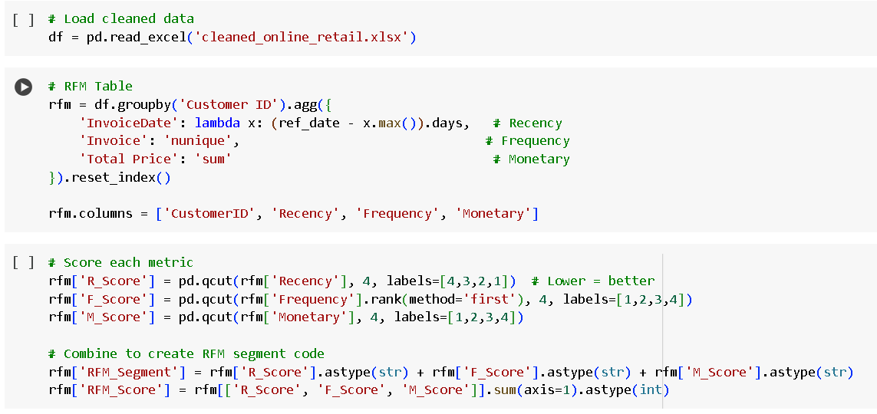
Customer Segmentation Using RFM Metrics
RFM Definition:
Recency: Days since last purchase.
Frequency: Number of transactions.
Monetary: Total spending.
Scoring Methodology:
Recency: Lower values = better (quartile-based: 1–4).
Frequency/Monetary: Higher values = better (quartile-based: 1–4).
RFM Score: Sum of R, F, and M scores (range: 3–12).

Slide 5
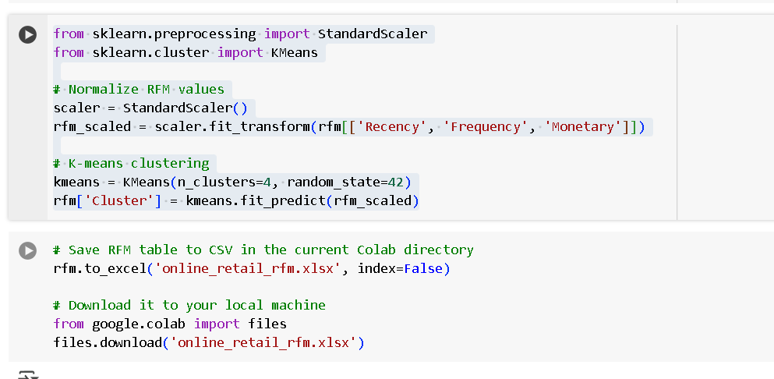
Unsupervised Learning for Deeper Insights (K-Means Clustering)
Cluster | Profile
0 | Low recency, low spending
1 | Moderate engagement
2 | High recency, high spending
3 | Recent, frequent purchasers

Slide 6
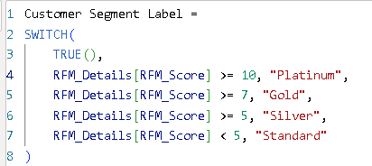
Customer Segmentation
Segment Definitions:
Platinum: Most valuable customers, highly engaged and high spenders.
Gold: Frequent and valuable customers.
Silver: Moderate engagement and spending.
Standard: Least engaged, opportunity for reactivation.

Slide 7
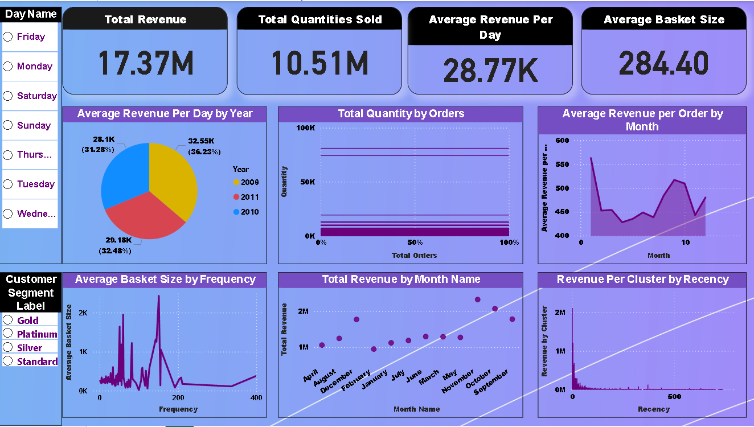
Executive Dashboard .

Slide 8
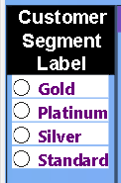
Main findings
High-value customers drive most revenue.
Clear patterns in revenue by month and day of the week.
Segmentation of customers enables targeted marketing.

Slide 9
Business Objectives & Data Overview
Purpose:
Identify customer groups for targeted marketing.
Analyze purchasing behavior by customer segments and day of the week.
Dataset:
Online retail transactions (2009–2011).
Key metrics: Invoice, Product, Quantity, Price, Customer ID, Country, Date.

Slide 10
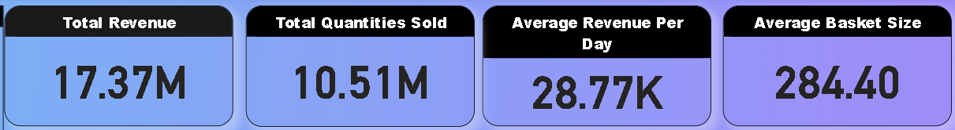
Key Metrics Overview
Total Revenue: Total sales generated.
Total Quantities Sold: Number of items sold.
Average Revenue Per Day: Daily sales performance.
Average Basket Size: Average Quantities per invoice

Slide 11
Total Revenue Analysis The total revenue recorded is $17.37M
Customer Segment Contribution
Platinum customers dominate revenue generation, contributing $14.02M, which is over 80% of total sales.
Gold customers follow with $2.44M, showing strong engagement but significantly less than Platinum.
Silver and Standard customers contribute $659.85K and $256.21K respectively, indicating lower transaction volumes or values.
Insight: Focused retention and upsell strategies for Platinum and Gold customers can drive sustained revenue. Consider marketing efforts to upgrade Silver/Standard users.
Weekday Revenue Patterns
Thursday sees the highest revenue at $3.75M, followed closely by Tuesday ($3.32M) and Wednesday ($3.02M).
Friday and Monday also perform steadily with $2.73M and $2.78M.
Sunday contributes $1.77M, while Saturday is notably the lowest at only $9.80K.
Insight: Midweek days (Tuesday to Thursday) are the strongest sales periods. Saturday may indicate limited operations or reduced customer activity—potential for growth via weekend promotions or campaigns.

Slide 12
Average Revenue per Order Analysis The overall average revenue per order stands at $28.77K,
By Customer Segment
Platinum: $23.21K per order — the highest contributor in both total and per-order revenue, confirming their premium value.
Gold: $4.04K — solid mid-tier performance, but far behind Platinum.
Silver: $1.18K — relatively low order value, showing potential for targeted growth strategies.
Standard: $597.24 — minimal contribution; likely casual or one-time buyers.
Insight: Platinum customers not only purchase more but also spend more per order. Loyalty programs or exclusive perks can further enhance this segment. There’s also opportunity to increase the order value of lower-tier segments through bundling or personalized offers.
Weekday Breakdown
Thursday leads with the highest average order value ($36.37K), followed by Tuesday ($31.95K), Monday ($29.56K), and Wednesday ($29.05K), while Friday dips slightly ($27.56K), and weekends drop sharply—Sunday ($17.87K) and Saturday lowest at ($9.80K).
Strategy Recommendation:
Focus marketing or sales pushes on Thursdays and Tuesdays to maximize high-value orders.
Consider targeted weekend promotions to boost both frequency and value of orders on Saturday and Sunday.

Slide 13
Average Basket Size Analysis The overall average basket size is 284.40 units per order
Customer Segment Breakdown:
Platinum: 312.51 units – Highest, reflecting large-scale or repeat bulk buying.
Gold: 231.87 units – Strong volume, though notably below Platinum.
Silver: 204.91 units – Moderate purchase sizes.
Standard: 124.93 units – Smallest baskets, likely occasional or low-value customers.
Insight:
Platinum customers not only drive revenue but also place the largest orders by quantity. Marketing strategies should aim to retain high-volume buyers and encourage larger baskets among Silver and Standard segments through bundles, loyalty rewards, or upsell tactics.

Slide 14
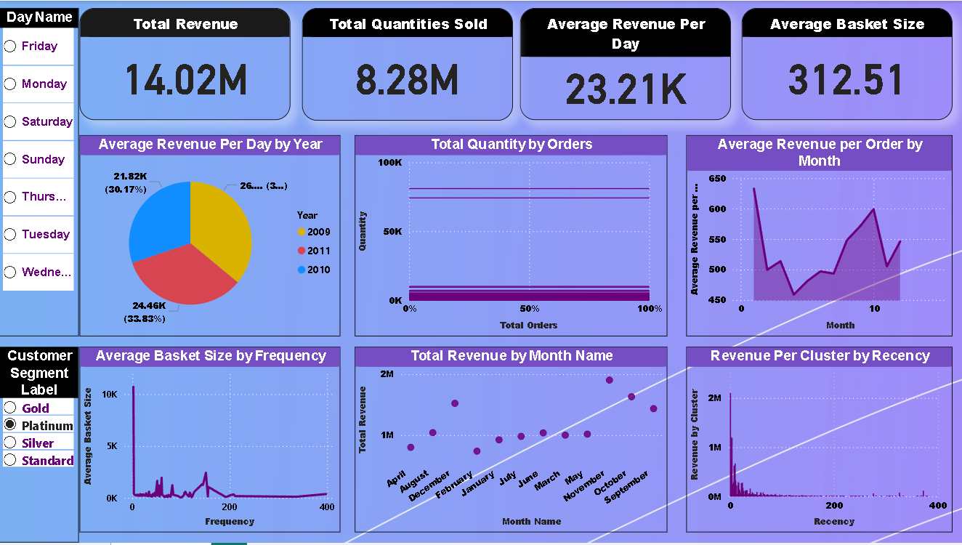
Platinum Segment – High-Value Customer Focus
Average Basket Size: 312.51
Average Order Value: $23,210
Total Contribution: $14.02M (over 80% of total revenue)
Performance:
Highest revenue and order value
Most frequent and strategic buyers
Recommendations:
Implement exclusive loyalty programs
Offer premium perks and early access
Personalize communication and prioritize retention

Slide 15
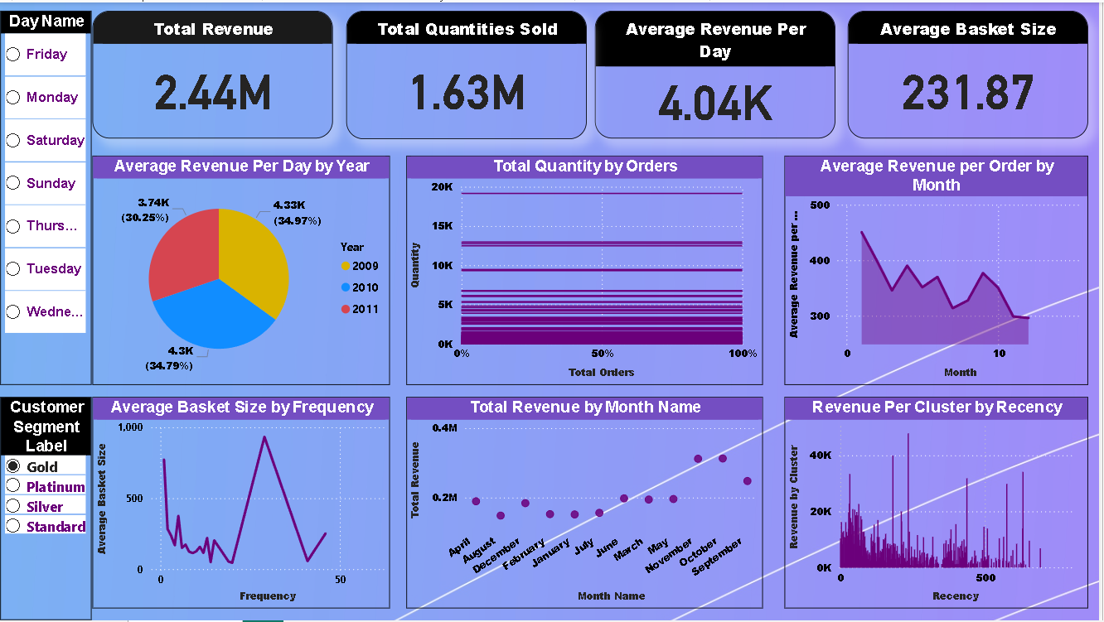
Gold Segment – Mid-Tier Engagement
Average Basket Size: 231.87
Average Order Value: $4,040
Total Contribution: $2.44M
Performance:
Strong engagement and consistent purchasing
Significant, but lower than Platinum
Recommendations:
Targeted upselling and cross-selling
Reward frequent purchases with tiered incentives
Encourage higher-value transactions

Slide 16
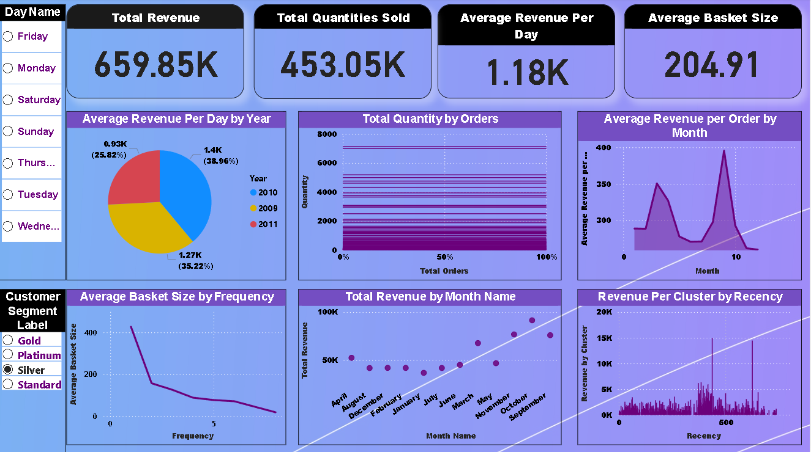
Silver Segment – Growth Opportunity
Average Basket Size: 204.91
Average Order Value: $1,180
Total Contribution: $659.85K
Performance:
Moderate engagement and lower order value
Opportunity for growth
Recommendations:
Personalized promotions and bundles
Re-engagement campaigns to boost frequency
Test incentives to increase basket size

Slide 17
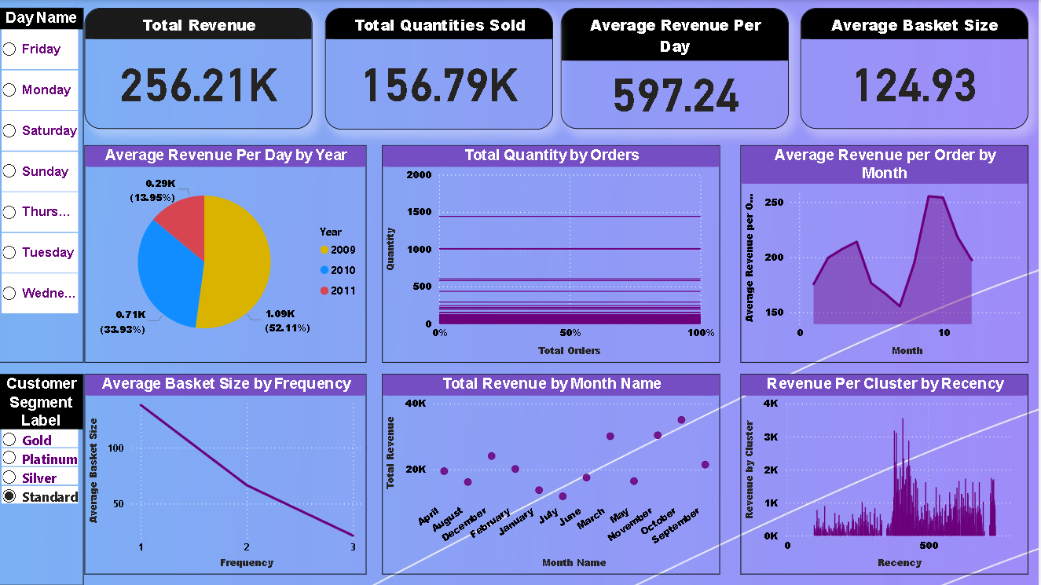
Standard Segment – Reactivation Potential
Average Basket Size: 124.93
Average Order Value: $597.24
Total Contribution: $256.21K
Performance:
Minimal contribution and low engagement
Likely casual or one-time buyers
Recommendations:
Win-back and reactivation campaigns
Discounts and feedback surveys
Focus on converting to higher-value segments

Slide 18
Conclusion
Customer segmentation using RFM analysis and k-means clustering has enabled a data-driven understanding of purchasing behavior in our online retail business.
Key insights reveal that Platinum and Gold customers contribute the majority of revenue, highlighting the importance of retention and loyalty strategies.
Segment-specific dashboards empower marketing teams to tailor campaigns and maximize engagement across all customer tiers.
Actionable recommendations for each segment—such as exclusive offers for Platinum, targeted promotions for Gold, and re-engagement for Silver and Standard—help optimize marketing spend and drive growth.
Continued monitoring and refinement of segmentation will ensure ongoing alignment with evolving customer needs and business objectives.

Slide 19
Thank You
Chaitanya Moudgil
+91-6232094664
chaitanya.moudgil5112@gmail.com
www.linkedin.com/in/chaitanya-moudgil-da

